Slide 1
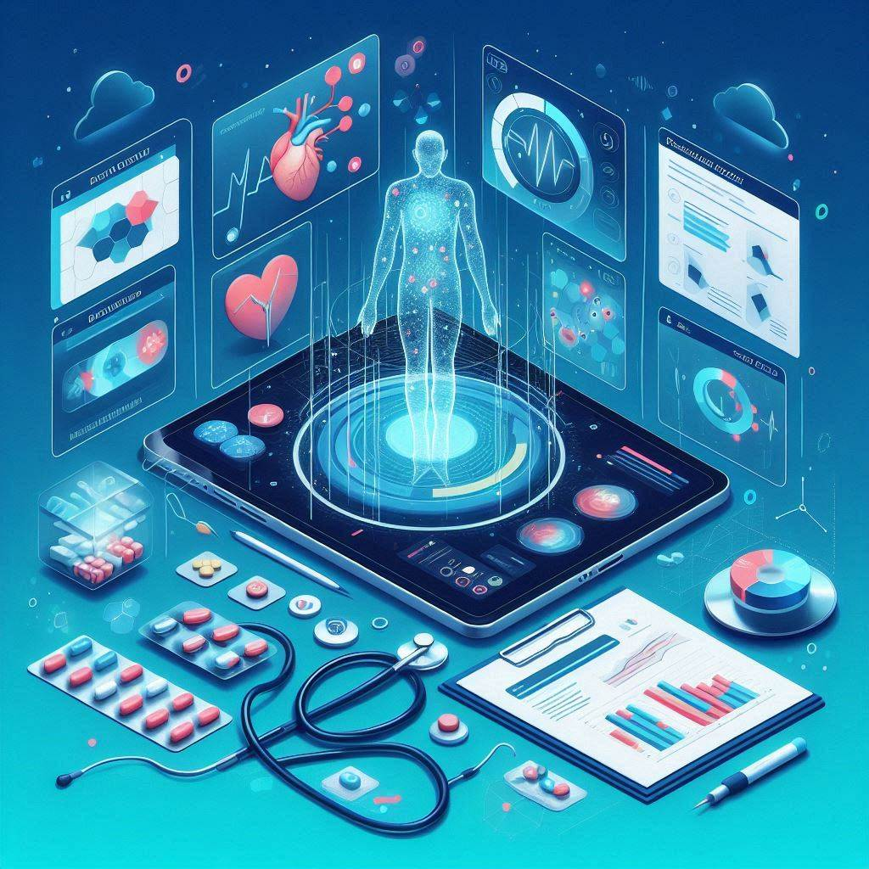

Disease Detection
AND
Medical Guidance
WITH
Image Analysis
For Patients
By:
Prashant 21BIT0524
Shashank Mishra 21BIT
Under Guidance of
Sumangali K

Slide 2
Literature Review
Challenges in Traditional Healthcare:
Limited access, high costs, and diagnosis delays.
Lack of AI-driven symptom detection with probable percentage
There is no such platform for prescription and medicine image analysis.
Need for Advanced AI Integration:
Real-time, accurate health assessments through generative AI with the probability of the disease.
The other platforms didn’t include the image analysis, so we are developing a platform for it.
Analysis of the doctor’s prescription to make the patients understand the technicalities and medicines.
User guide for the medical tool images uploaded by users directly through the camera.
Rationale for CureAI:
Reduces reliance on traditional healthcare by offering AI-driven solutions for proactive health management in an affordable manner.

Slide 3
Gap Identification
Traditional healthcare systems lack comprehensive platforms for disease analysis and holistic AI health management.
Users struggle to determine the disease based on the symptoms they are experiencing.
Existing solutions do not offer integrated features such as medical tool scanning, medication info with side-effects & dosage etc.
There is a need for an affordable, cross platform, user-friendly, and technologically advanced platform that addresses these needs.

Slide 4
Objectives
Develop an AI-Driven Healthcare Platform: Focus on creating a comprehensive system for early disease detection based on symptoms in natural language.
Democratize Access to Healthcare: Ensure that medical advice is affordable and accessible, regardless of geographical location or language.
Integrate Multiple Healthcare Functionalities: Provide real-time symptom analysis, prescription scanning, and medical tool usage instructions within a single, user-friendly interface.
Empower Users: Enable users to take control of their health, promoting preventive care and reducing reliance on traditional healthcare systems.

Slide 5
cureAI Features
A single platform where users can get early disease prediction along with it’s treatment, other symptoms & effects, Personalized exercises.
Prescription scanning, shows directions to use them, benefits, side effects and Dosage guide directly from the camera/image.
Users can scan any medical tool image to get a step-by-step usage guide on them.
Features:
Symptom based Disease Detection
Medicine analysis through image
Affordable to use
Accessible on all devices
Natural language support + Chatbot
Medical tool usage directions
Digital Prescription analysis through image

Slide 6

Tech Stack
Frontend:
HTML, CSS, Tailwind CSS
Backend:
HuggingFace backend, NodeJS
APIs:
Blip-image-captioning, Generative AI

Slide 7
Project Plan
Research Phase: Conducted an in-depth analysis of existing healthcare solutions to identify gaps and opportunities for innovation
Design Phase: Developed a user-friendly interface using Tailwind CSS, having various user fields for entering symptoms or images.
Implementation Phase: Built core features including symptom-based disease detection, prescription scanning, and medical tool guidance. Integrated generative AI models and ensured cross-platform compatibility.
Testing Phase: Performed rigorous evaluations to ensure accuracy, reliability, and security of the platform.
Deployment Phase: We will launch CureAI on a scalable, cloud-based infrastructure - onrender. Continuous updates are planned to enhance features and performance based on user feedback.

Slide 8
Design
Design Approach: User-Centered Design: CureAI is designed with the end-user in mind, offering an intuitive interface that simplifies navigation through various healthcare services such as symptoms entering, image uploading.
Responsive Web Design: The application uses Tailwind and manual CSS to ensure the interface is responsive and accessible across different devices, from mobile phones to desktops.
Modular Design: The code is structured modularly, with separate scripts for different components, such as the header, footer, and main content, facilitating easier updates and maintenance.

Slide 9
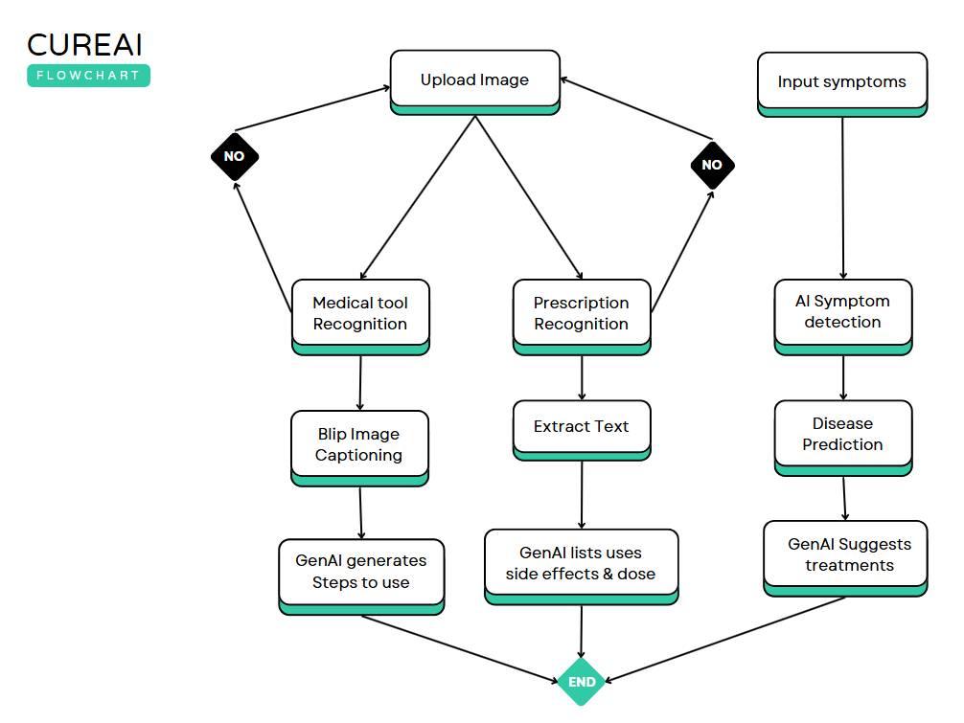
CureAI Architecture
Tessaract
GenAI
GenAI
GenAI

Slide 10
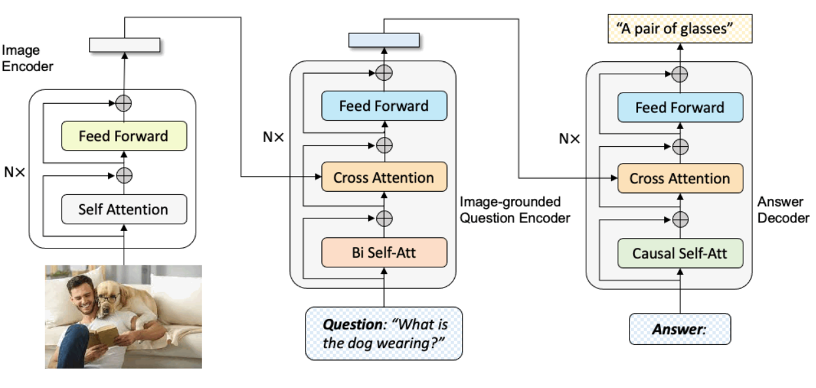
Blip captioning Model Architecture

Slide 11
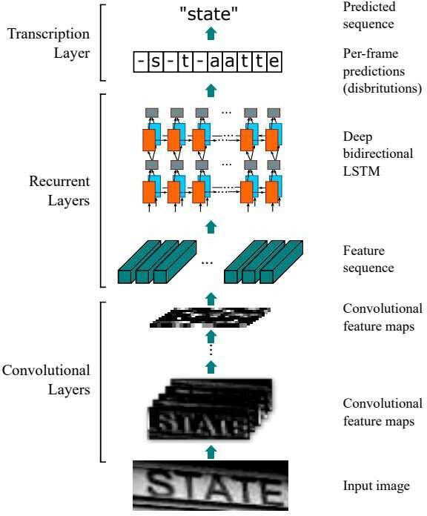
Tessaract Architecture

Slide 12
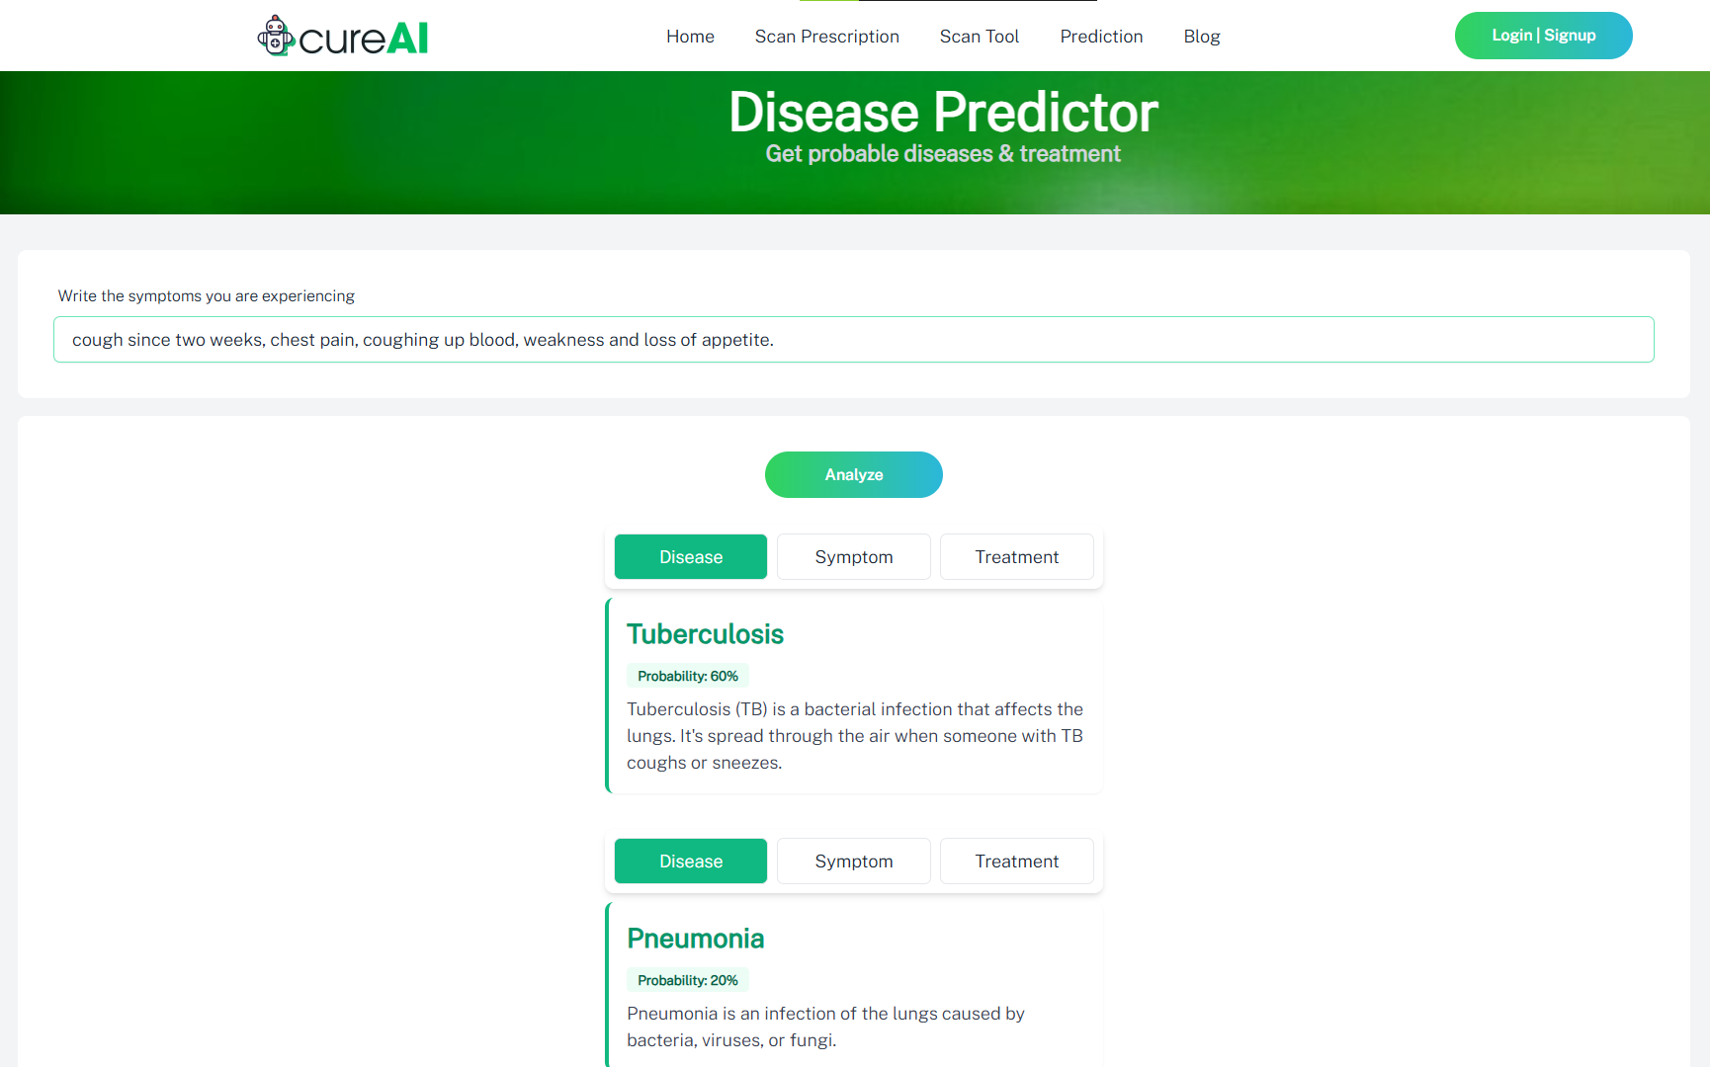
Working Screenshots: Predictor

Slide 13
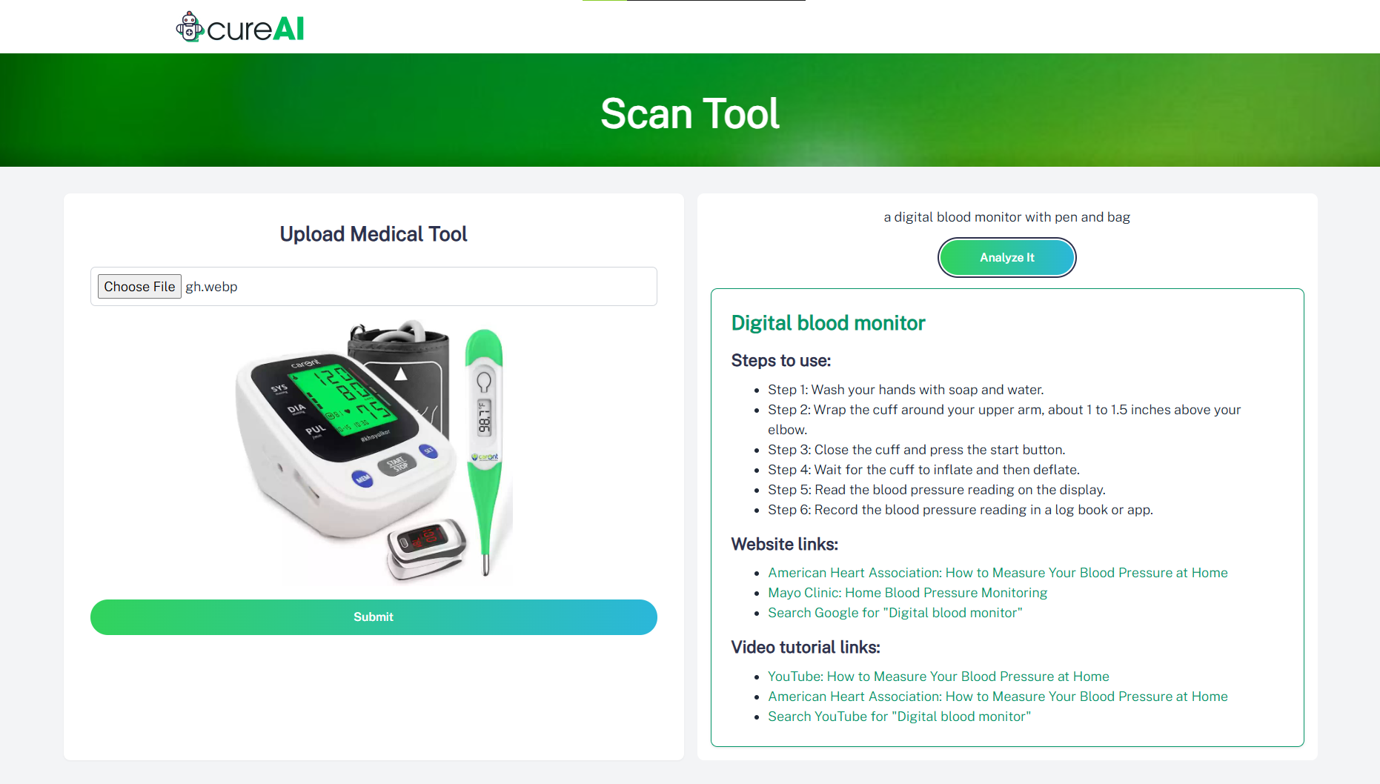
Working Screenshots: Tool Scanner

Slide 14
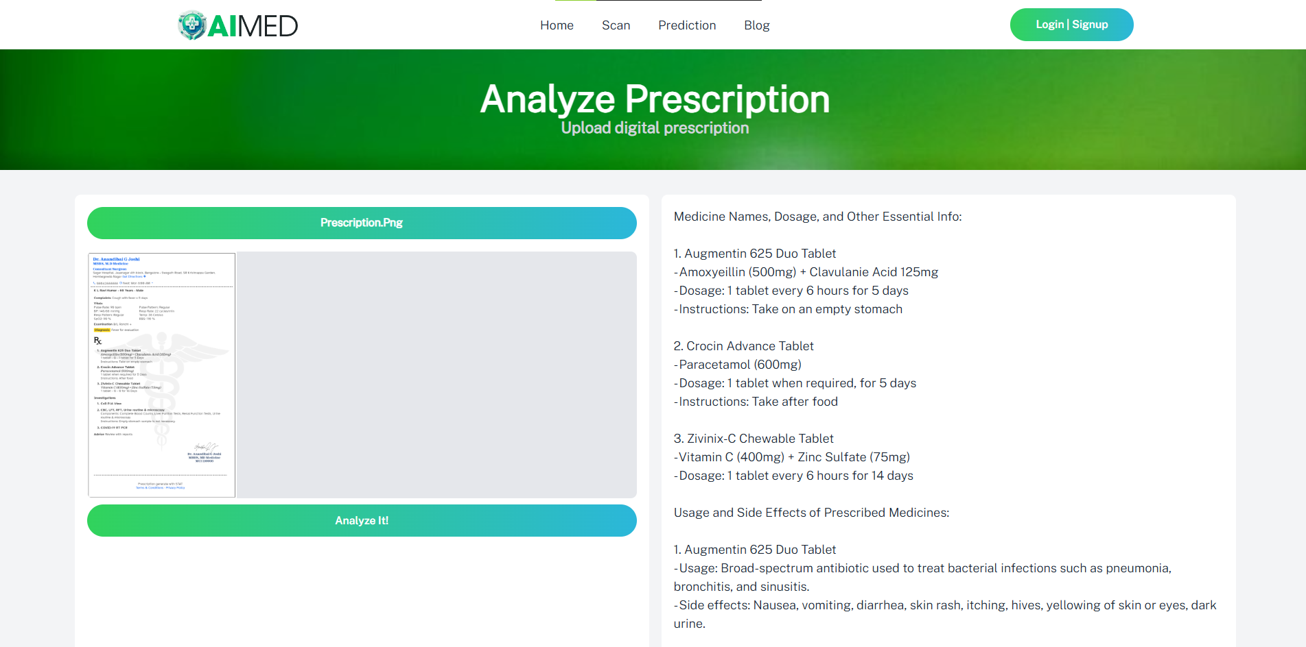
Working Screenshots: Prescription

Slide 15
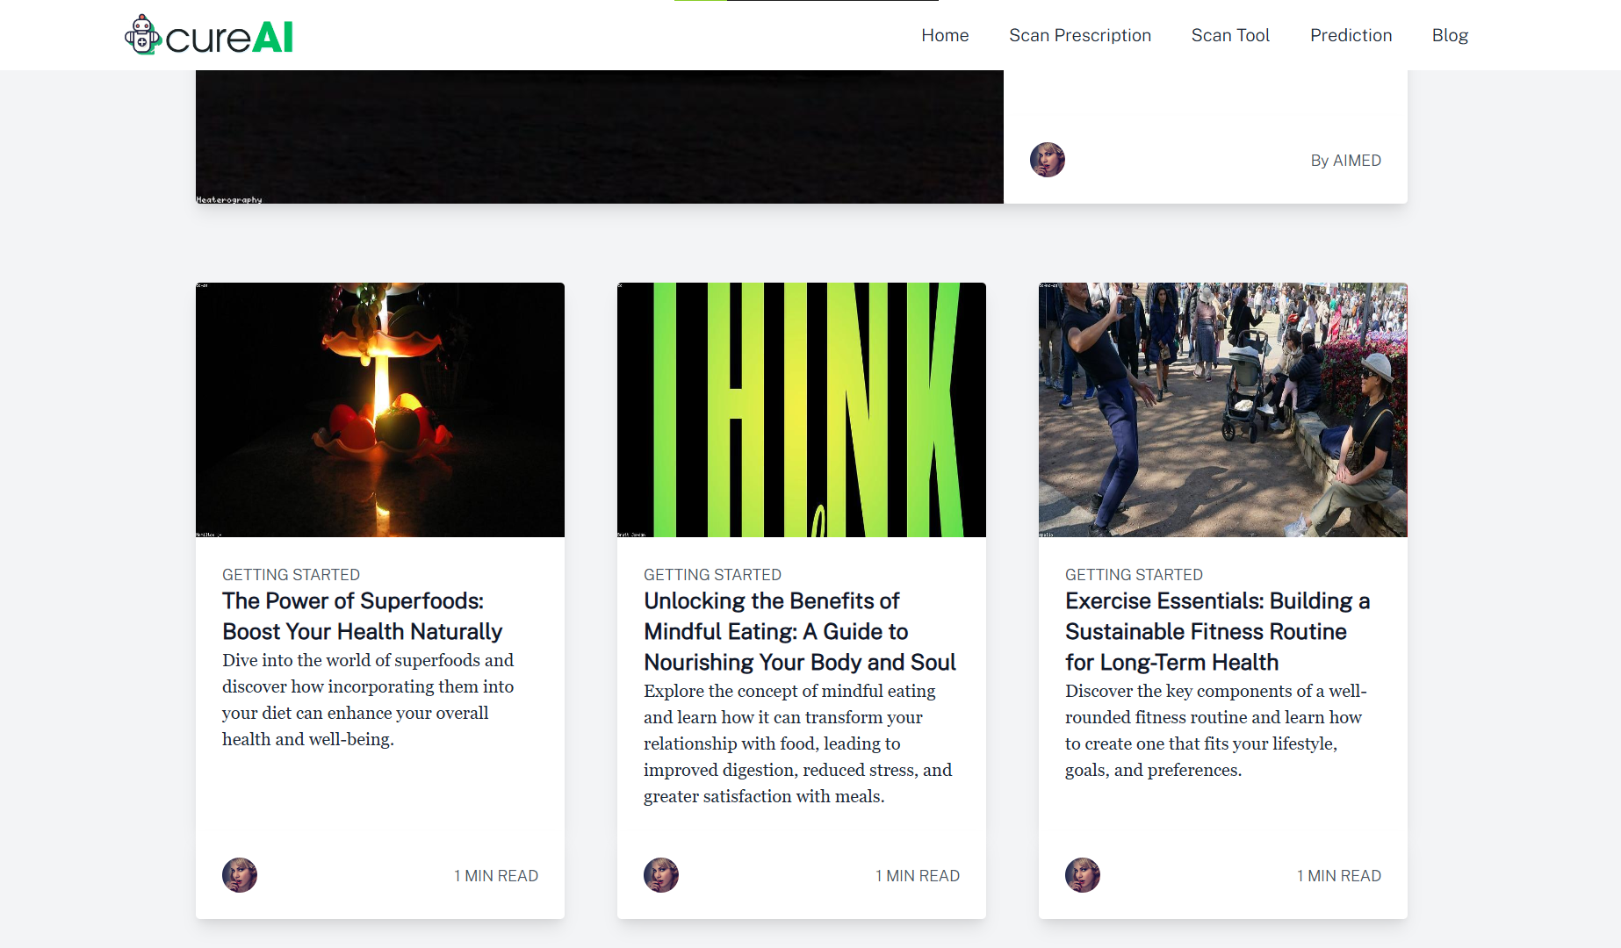
Working Screenshots: Blogs

Slide 16

Business Model | Future Scope
1.
Key Partners & Resources
Healthcare Providers: Partnering for specialized care.
AI Technology Companies: Google’s generative models.
Marketing Agencies: Promotional activities and user acquisition.
2.
Revenue Streams
Subscription Model: Tiered plans for premium features such as Doctor / AI chats.
Advertisement Revenue: Partnering with healthcare brands with ADsense.
Premium Content: Local recommended doctors & Medics contact and location.
3.
Customer Segments
Health-Conscious Individuals: Seeking personalized health solutions.
Healthcare Professionals: Assistance by Doctors, trainers.

Slide 17
References
1. Tailwind CSS Documentation
Utility-first CSS framework documentation for building custom UIs.
2. Hugging Face Models
Repository of AI models for NLP, image captioning, and more.
3. GDPR Compliance Guidelines
Guidelines for ensuring data privacy and protection under GDPR.
4. W3C Accessibility Standards (WCAG 2.1)
Standards for designing accessible web content for all users.
5. AI in Healthcare: Applications and Trends
Overview of AI applications and trends in healthcare.
6. Introduction to Secure Coding Practices
Best practices for preventing common coding vulnerabilities.

Slide 18
Thank You

